Slide 1
系統晶片設計實習 過程紀錄 (ZedBoard – Vivado 2018.2)
F107112116 李冠賢

Slide 2
目錄
LAB1
LAB2
LAB3
中斷

Slide 3
LAB1
建立專案、選擇開發板 和 coding語言
建立底板選擇開發板
建立空IP package

Slide 4

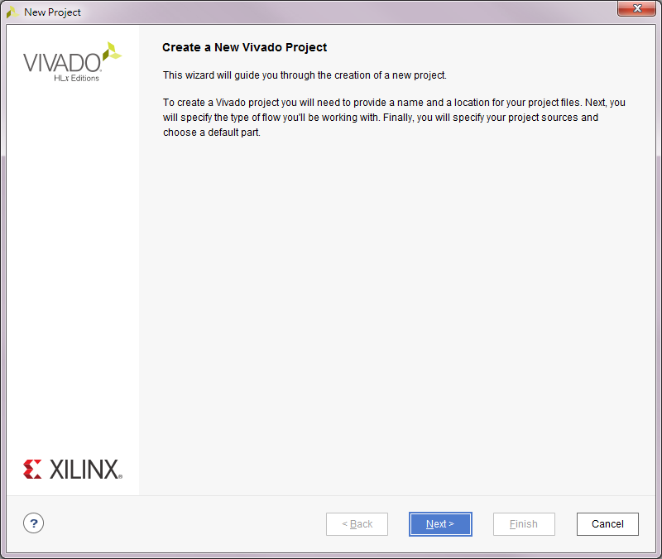
建立專案、選擇開發板 和 coding語言

Slide 5
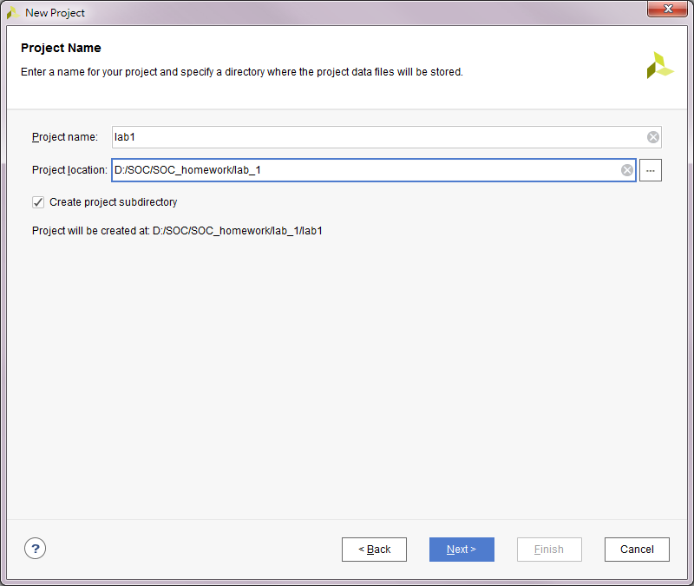
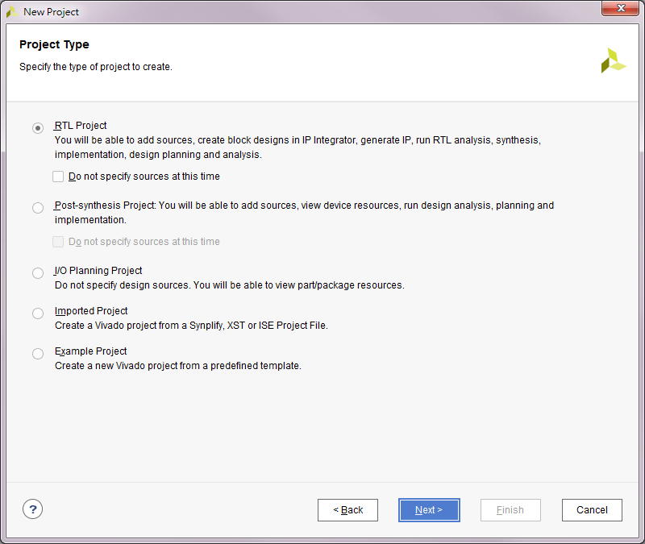
建立專案、選擇開發板 和 coding語言

Slide 6
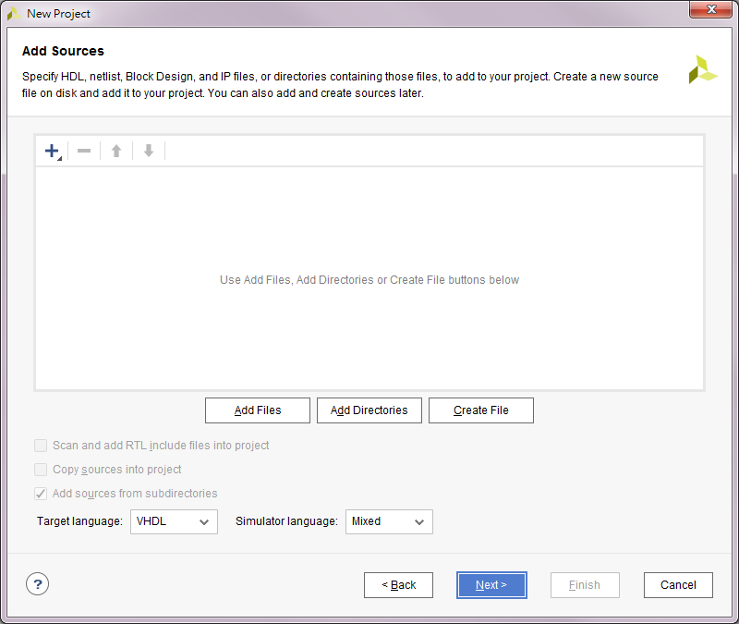
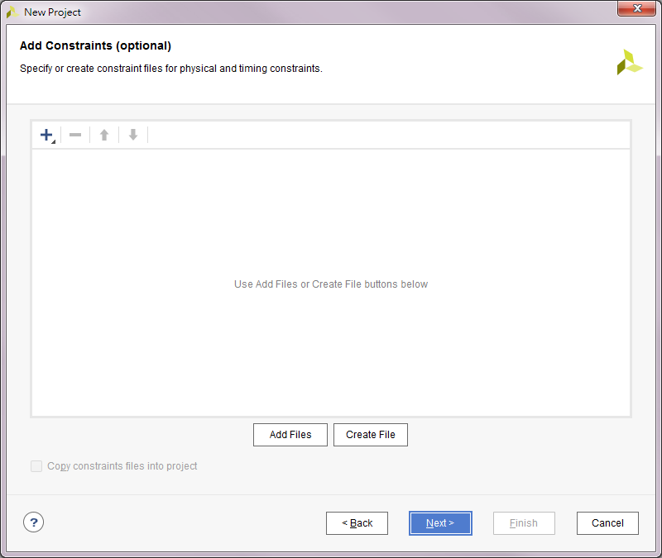
建立專案、選擇開發板 和 coding語言

Slide 7
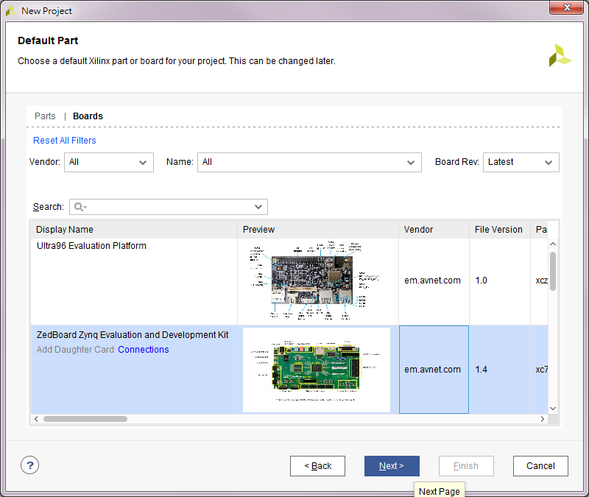
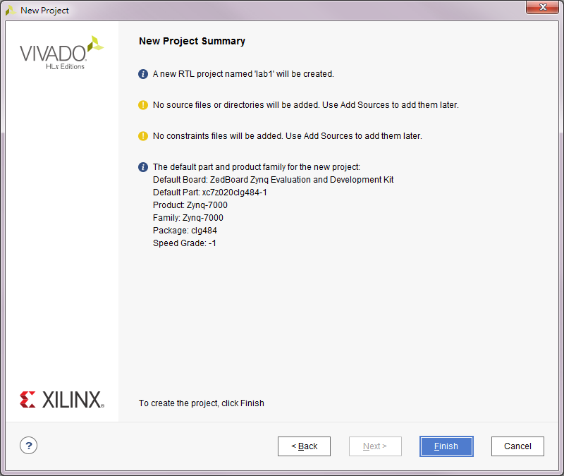
建立專案、選擇開發板 和 coding語言
1
2

Slide 8
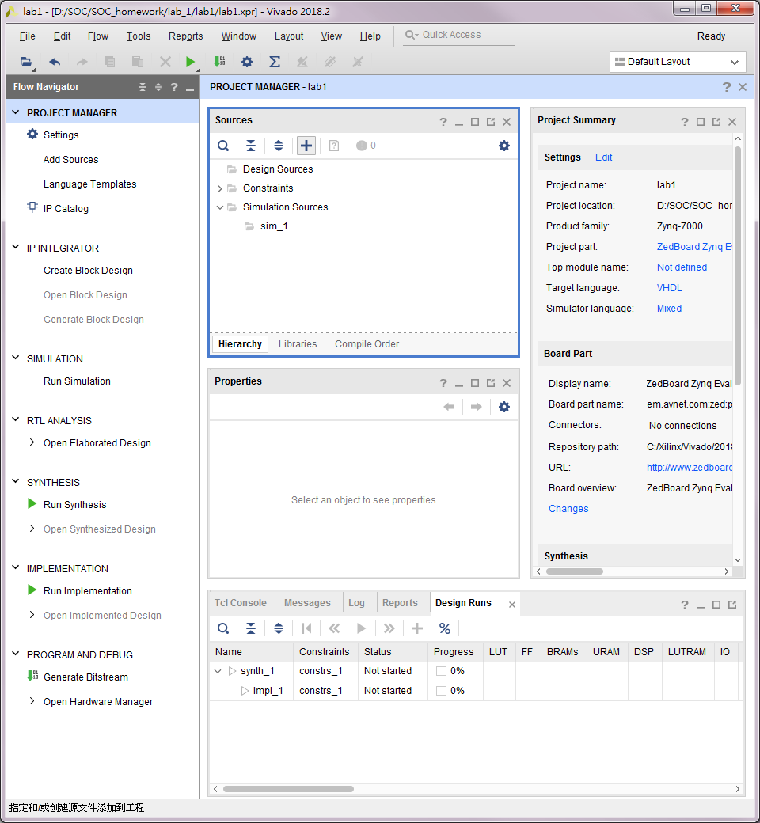
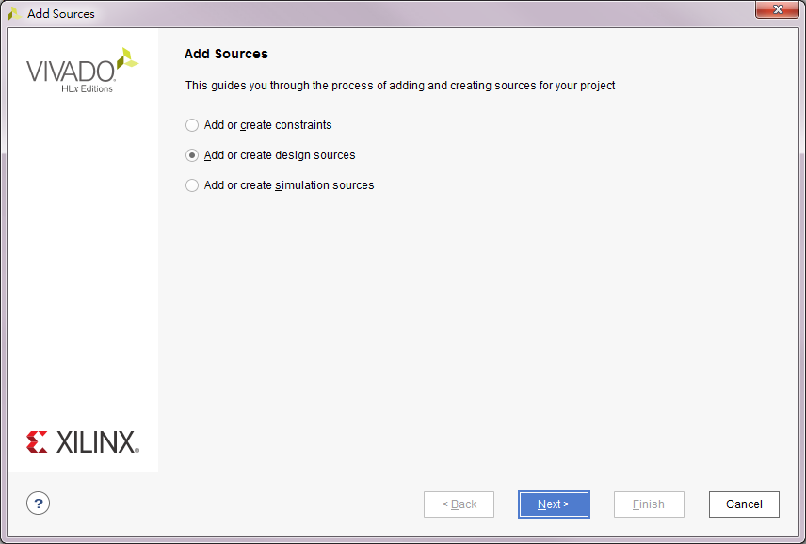
建立專案、選擇開發板 和 coding語言

Slide 9
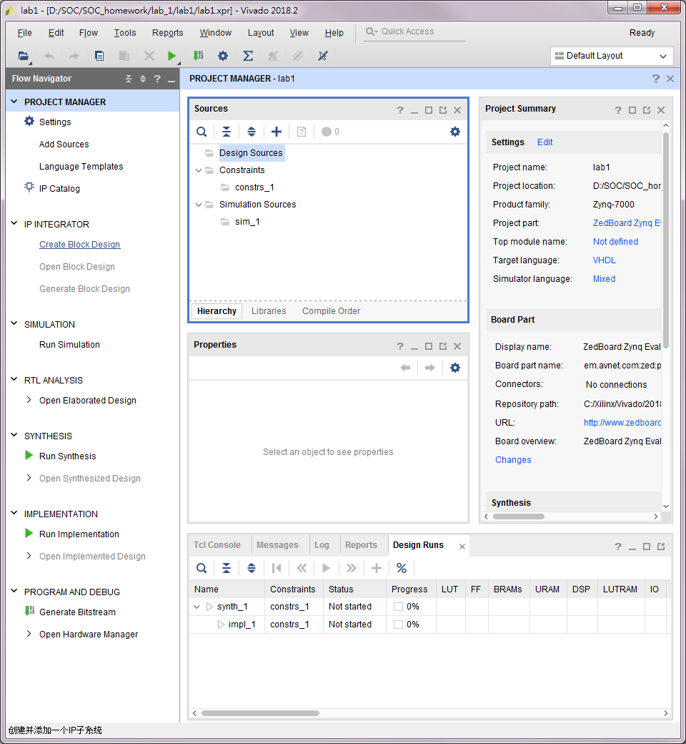
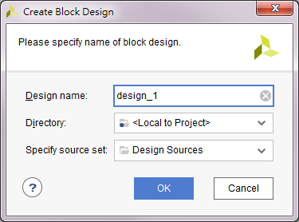
建立底板選擇開發板

Slide 10
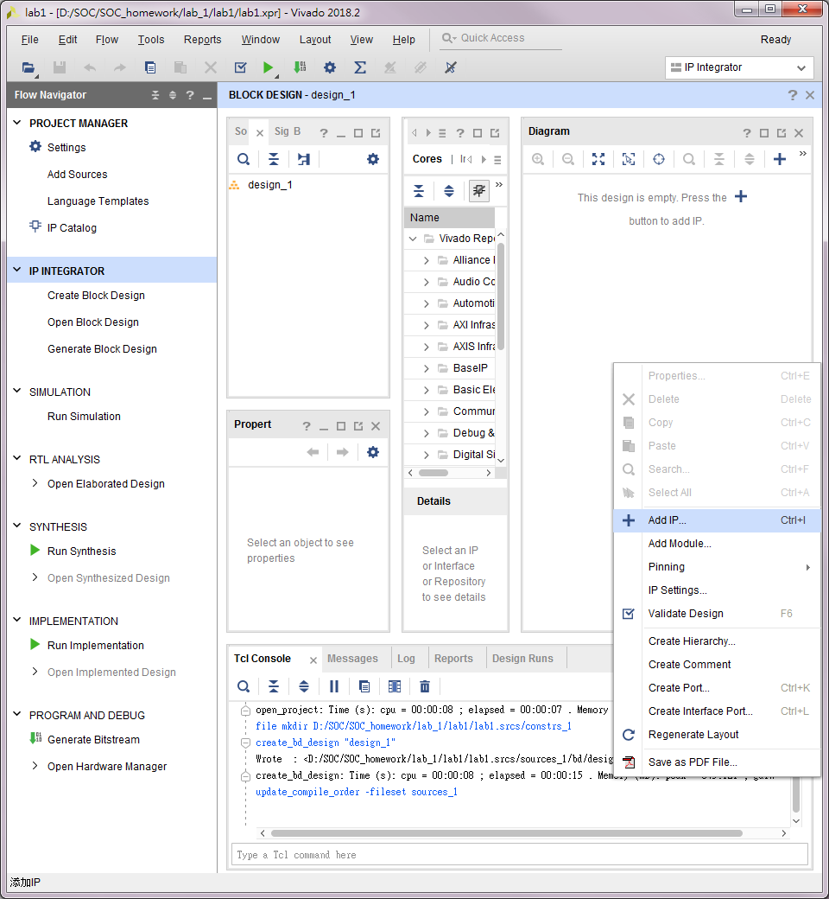
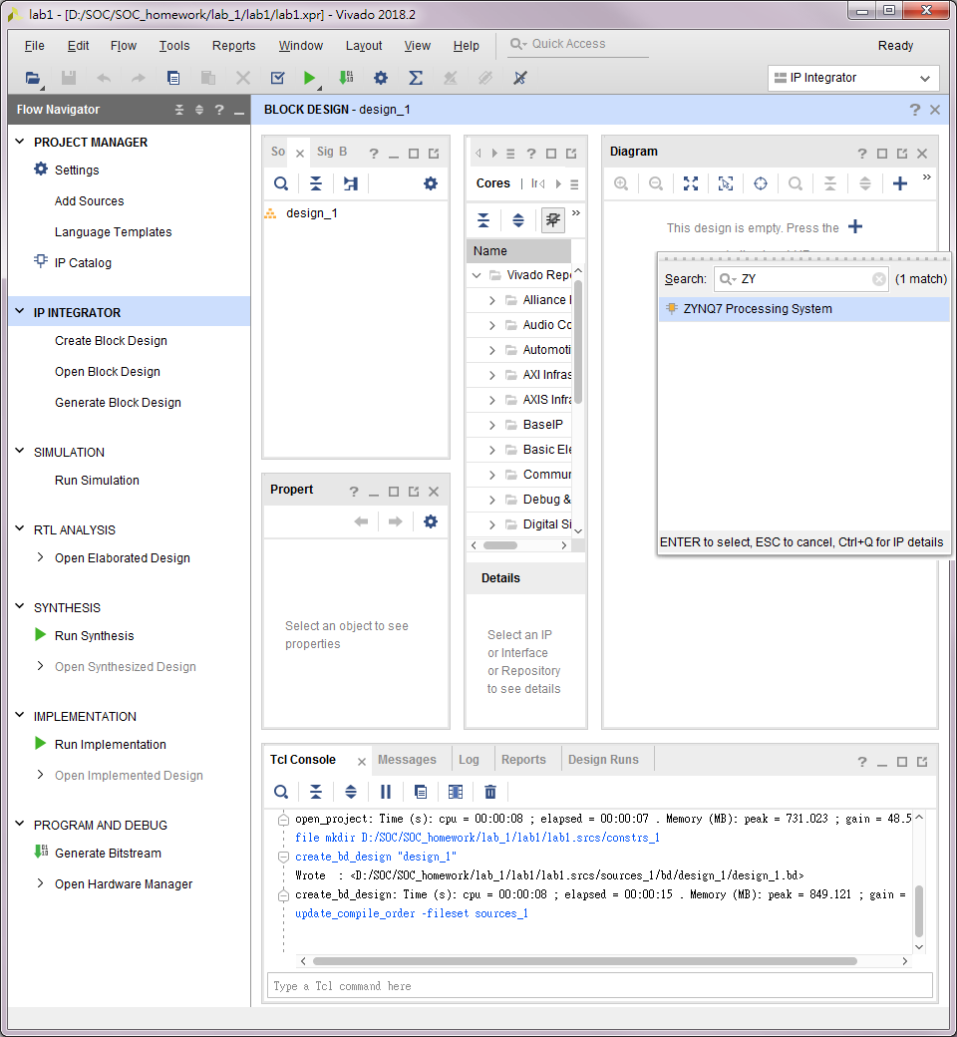
建立底板選擇開發板

Slide 11
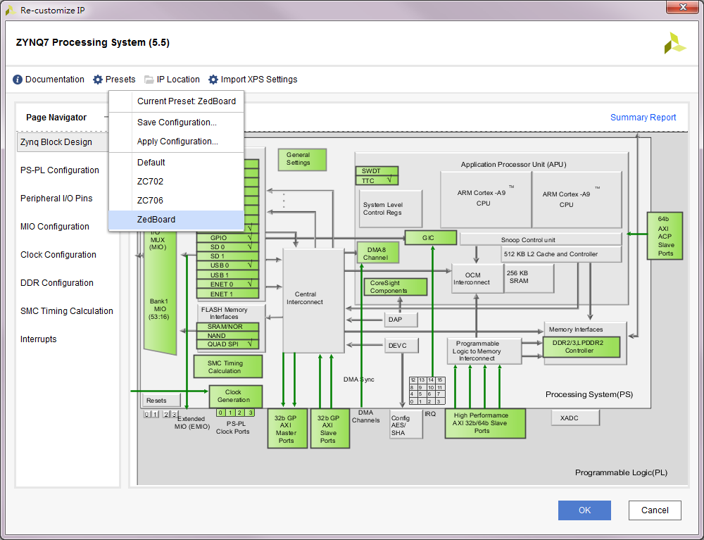
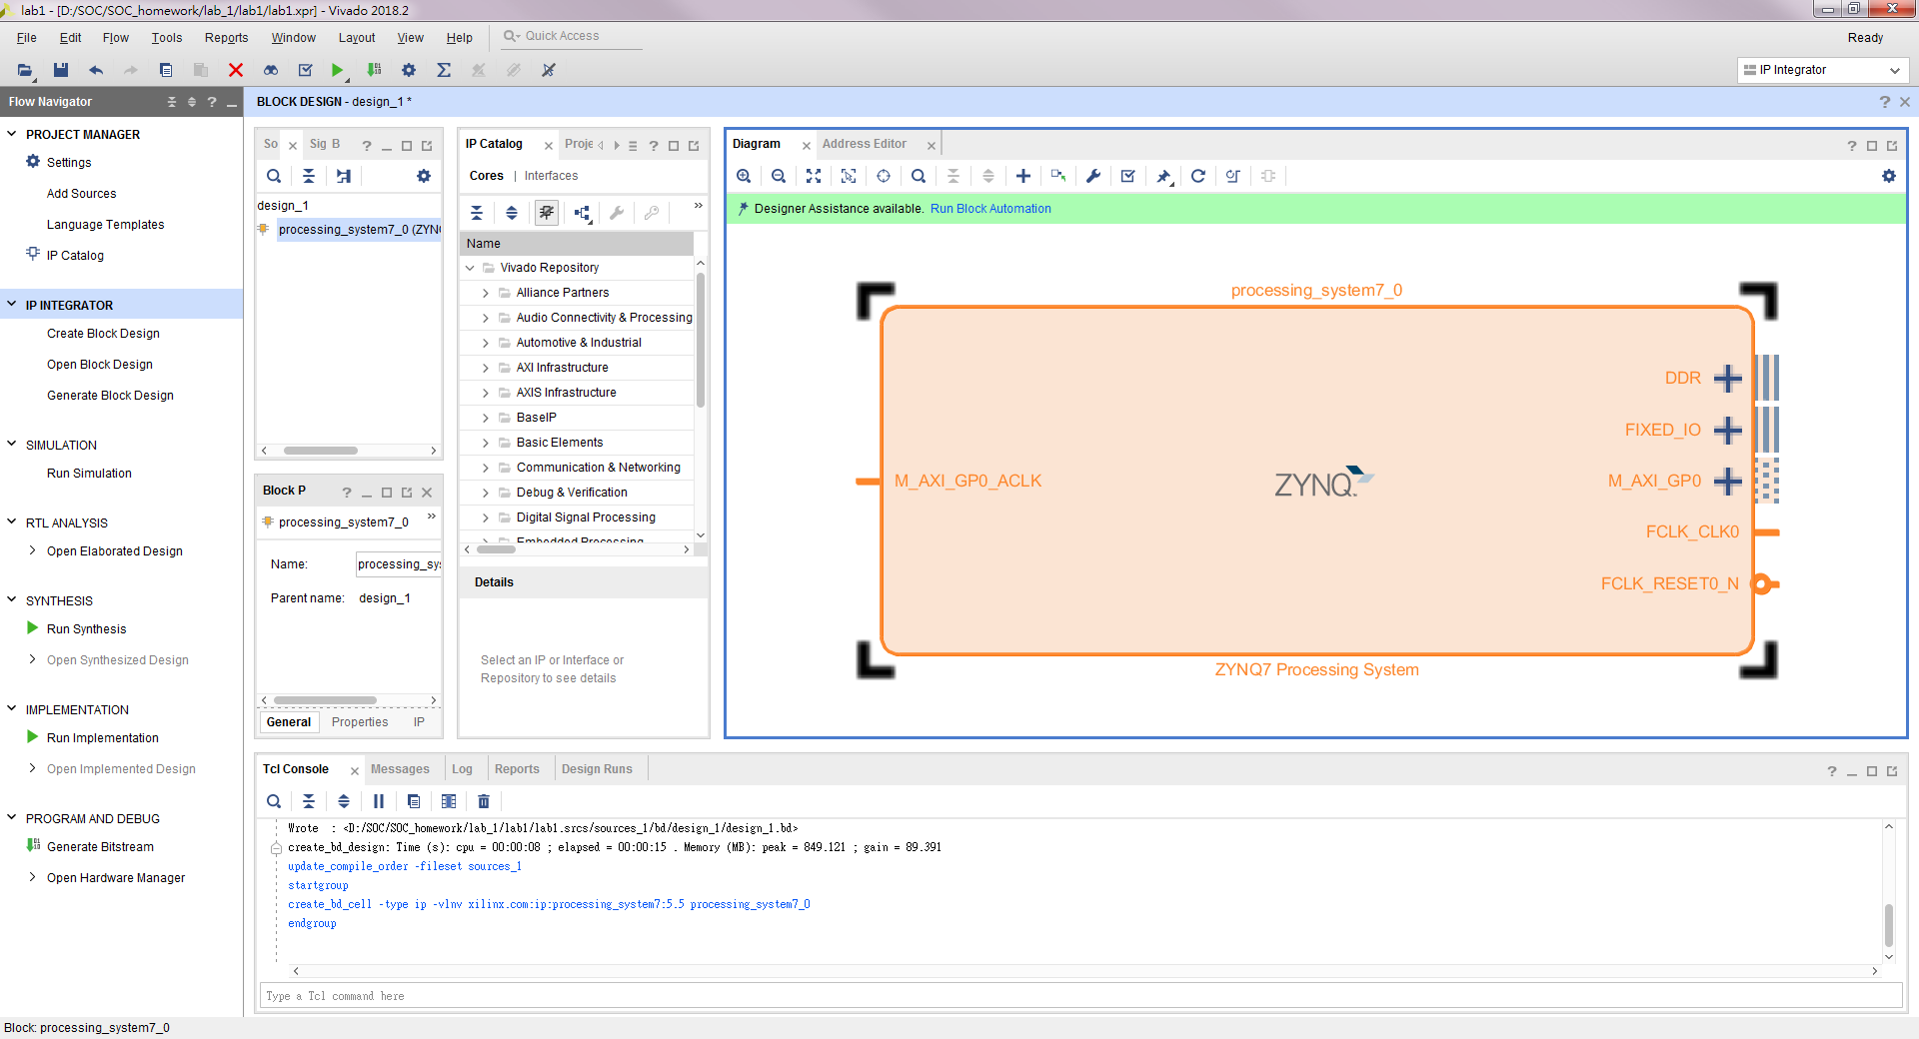
建立底板選擇開發板
1
2
1 雙擊
3

Slide 12
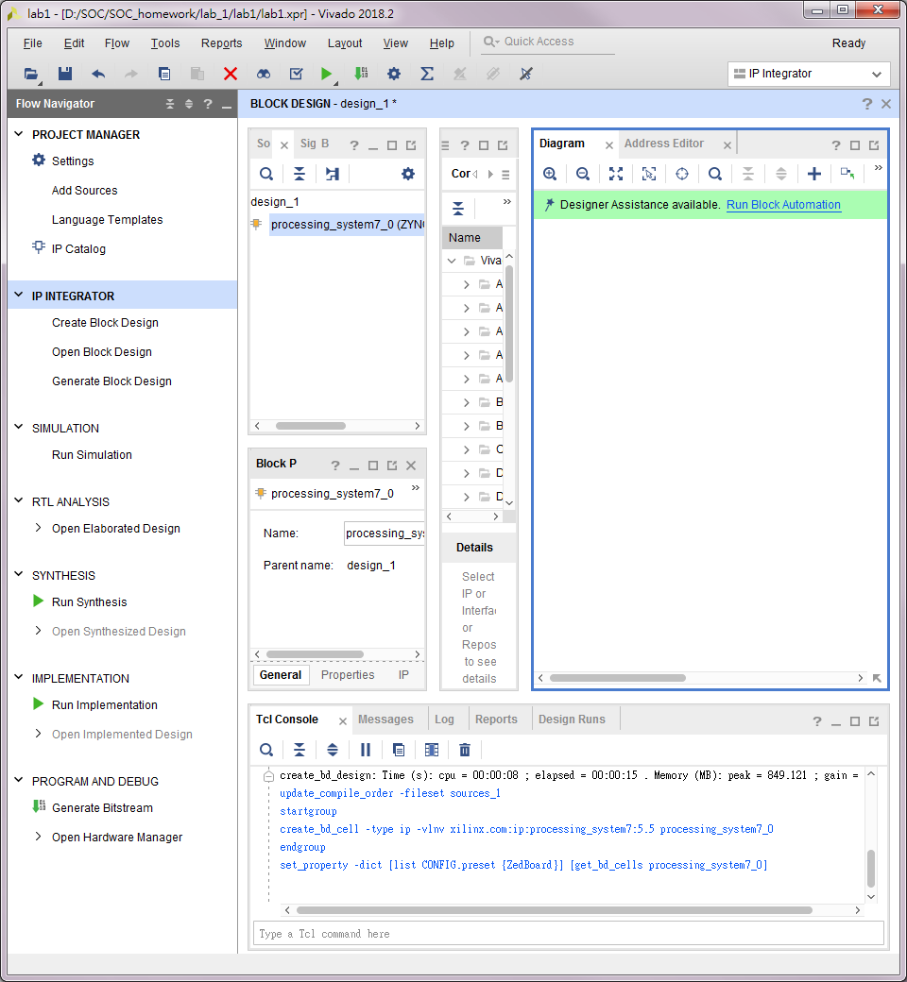
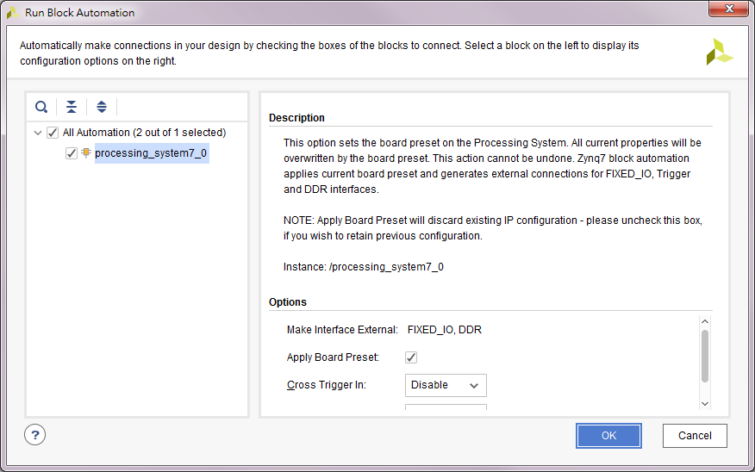
建立底板選擇開發板
1
2

Slide 13
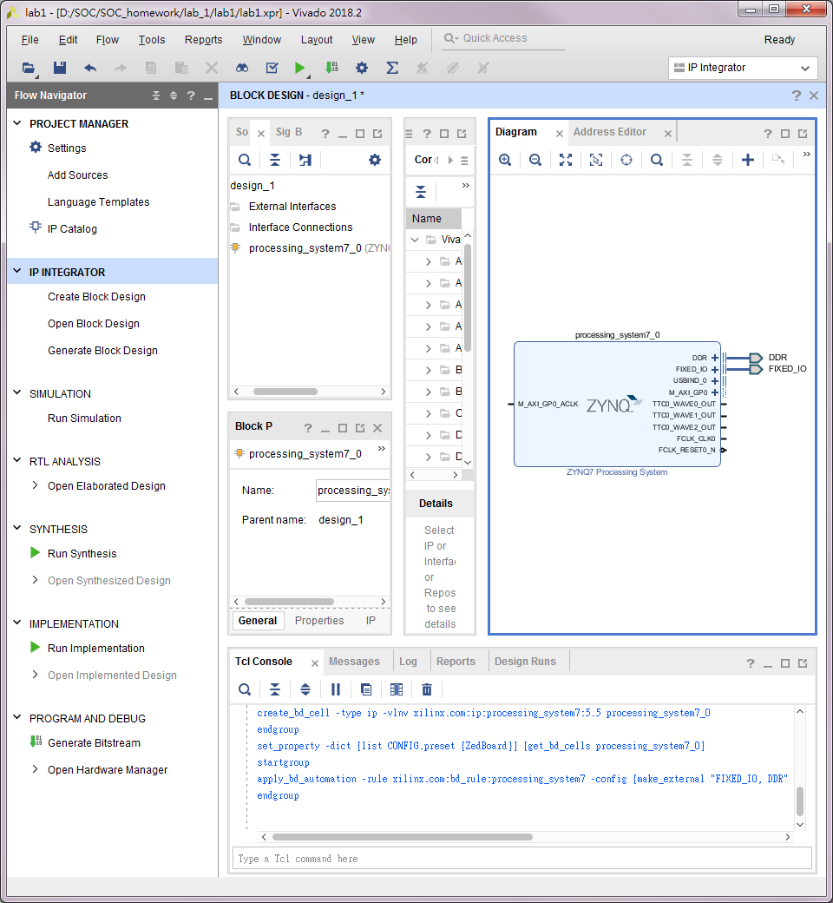
建立底板選擇開發板

Slide 14
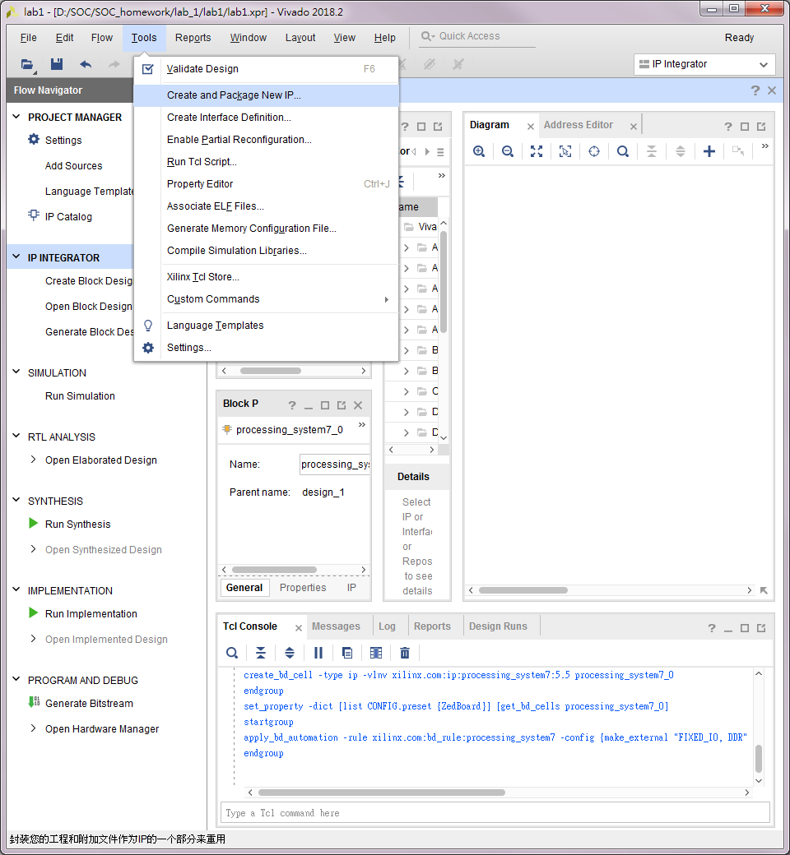
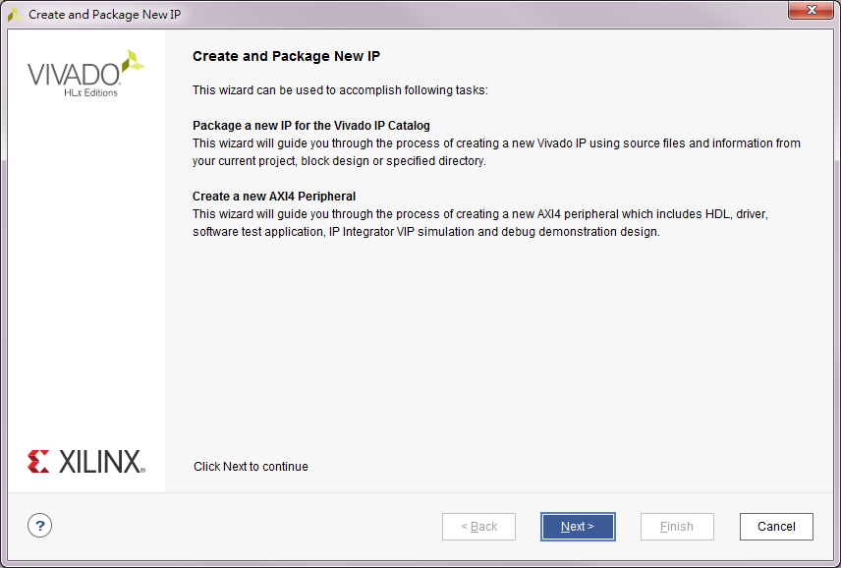
建立空IP package
1
2

Slide 15
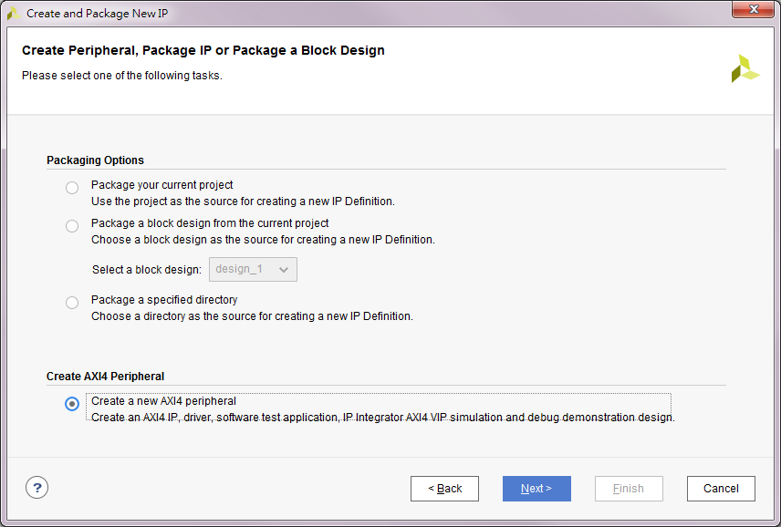
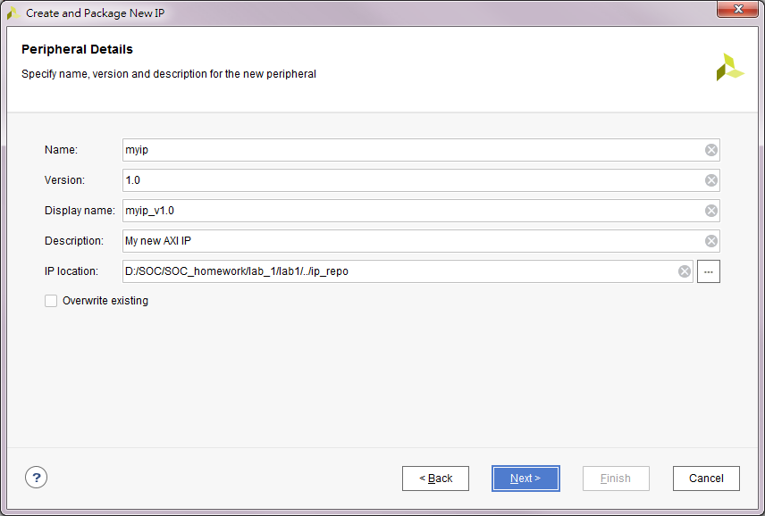
建立空IP package
3
1
2
4

Slide 16
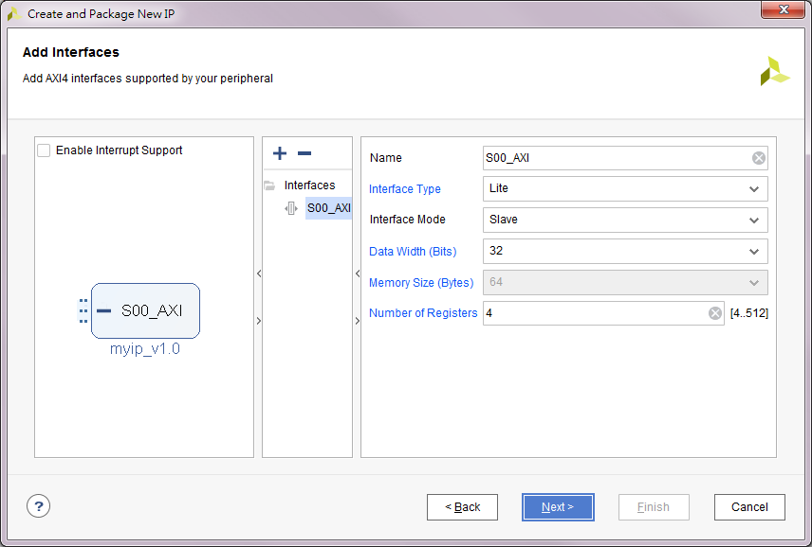
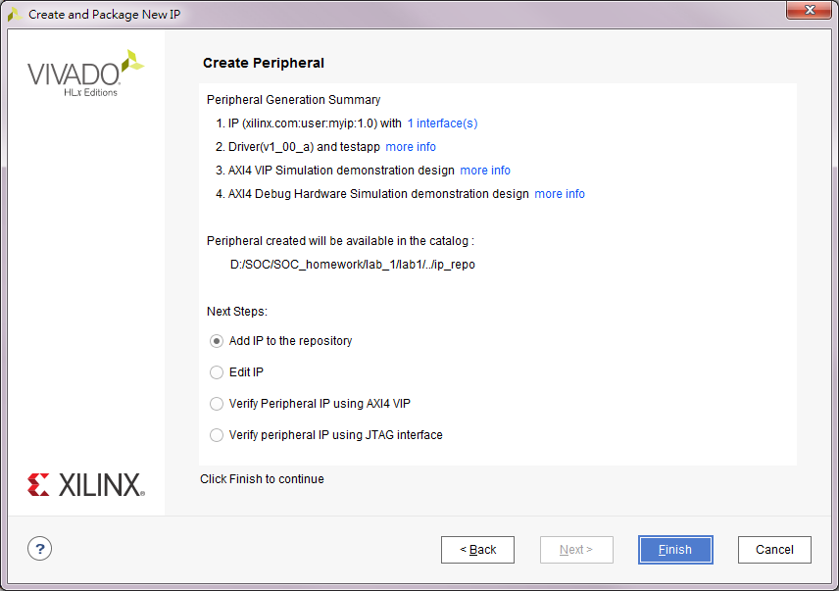
建立空IP package
1
3
2
4

Slide 17
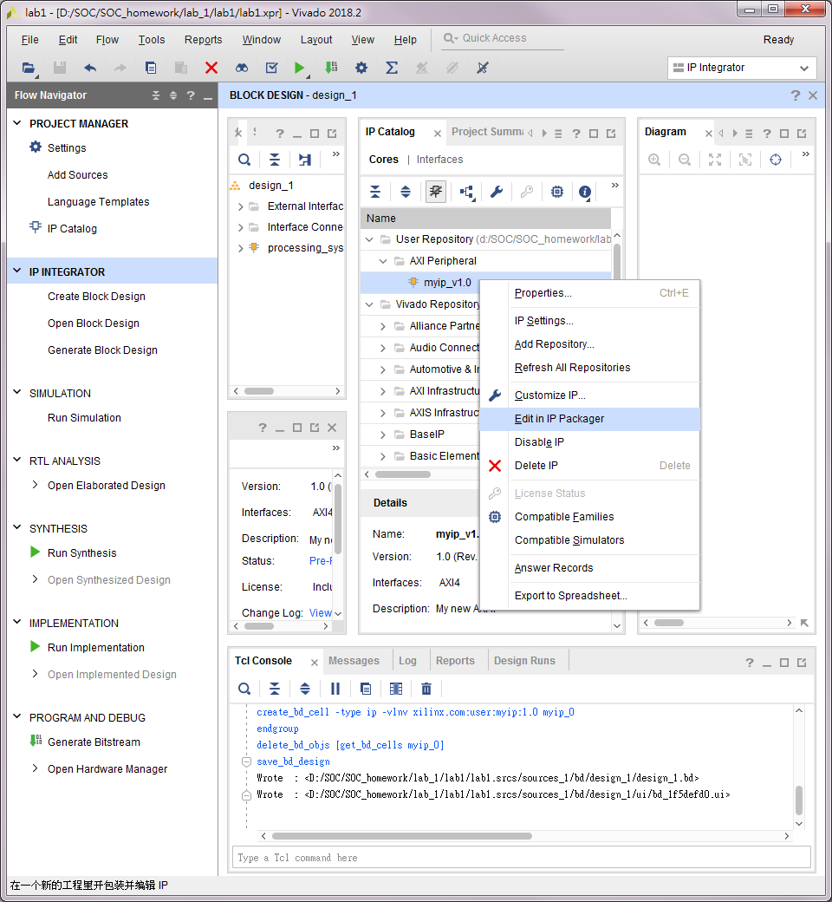
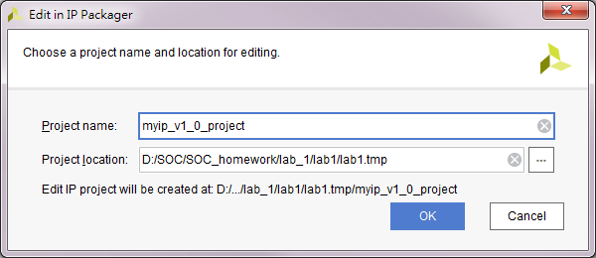
修改IP 建立專案
1
2右鍵
3
4

Slide 18
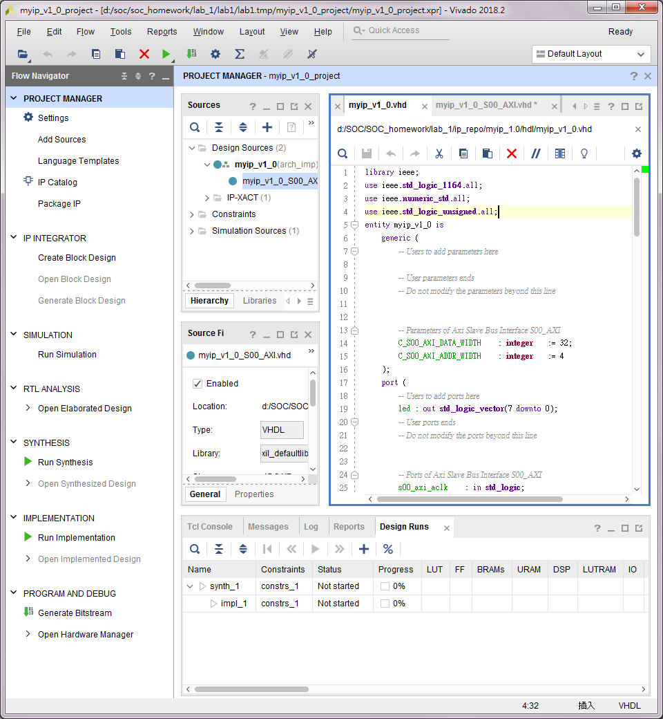
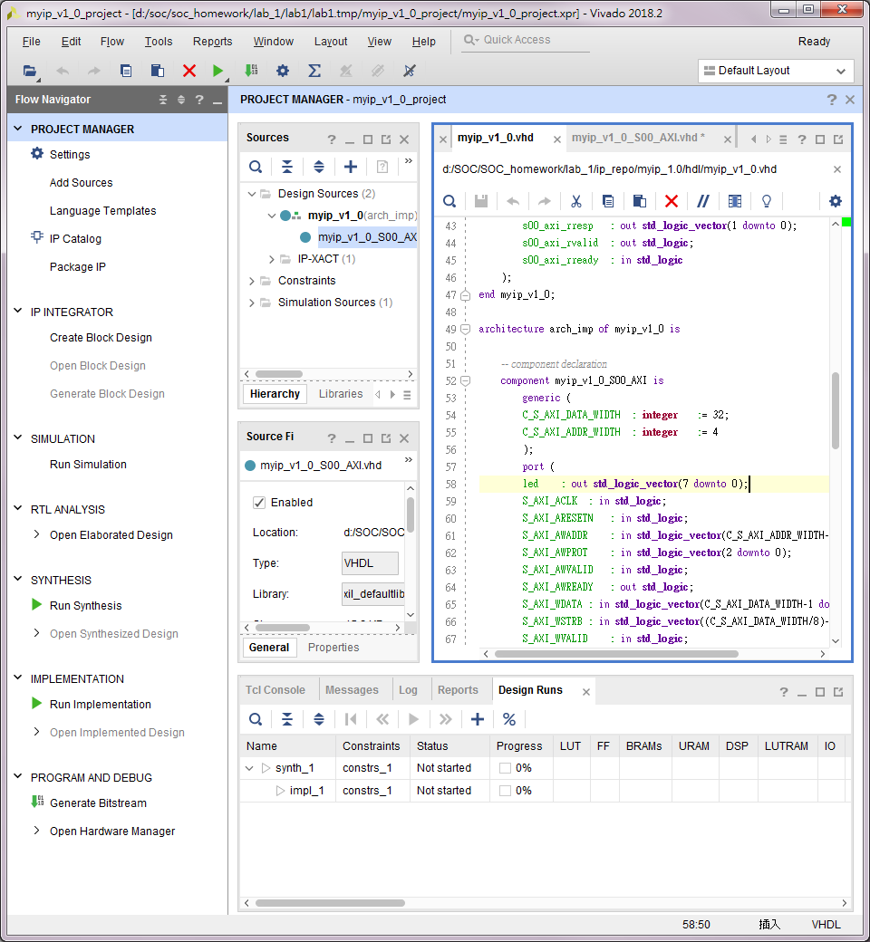
修改IP myip_v1_0.vhd

Slide 19
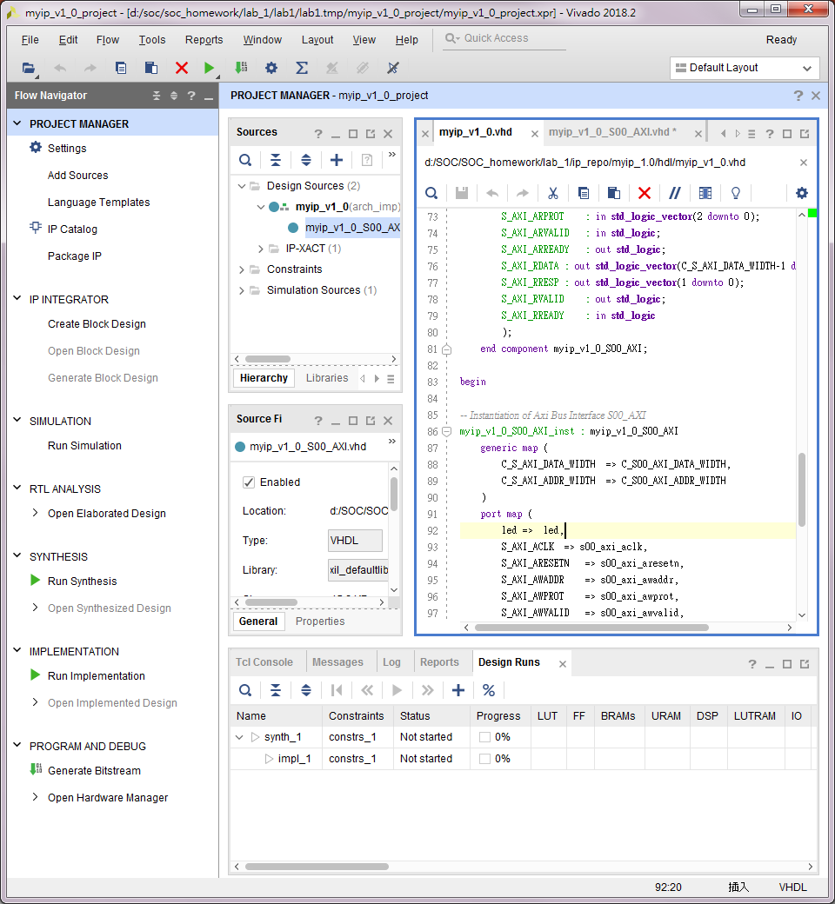
修改IP myip_v1_0.vhd
更改完程式碼後 Ctrl+S 儲存

Slide 20
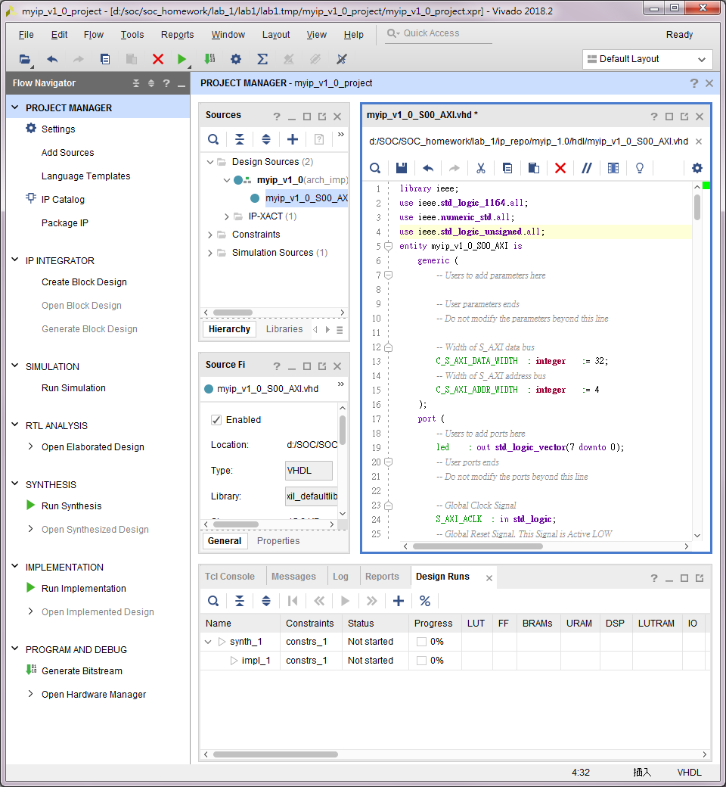
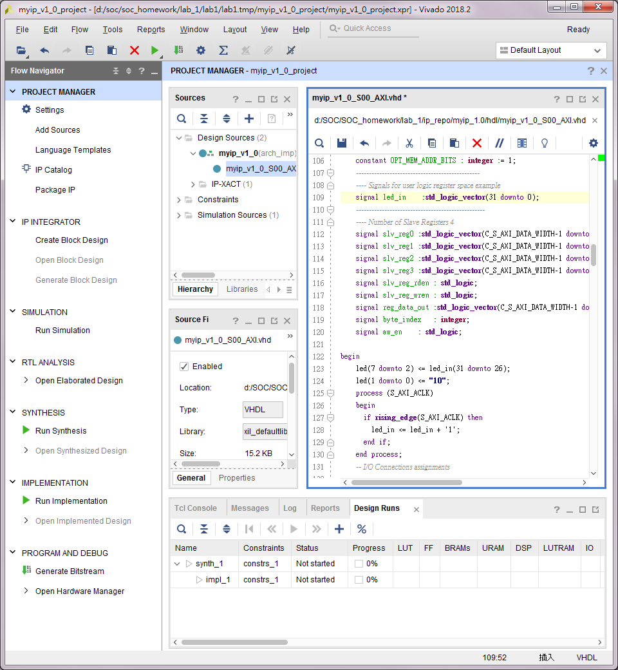
修改IP myip_v1_0_S00_AXI.vhd
1
3
2
4
5.4處均更改完後 Ctrl+S 儲存
led[7:2]計數器輸出，判斷S_AXI_CLK是否有震盪
led[1:0]高低態顯示，判斷燒錄是否成功

Slide 21
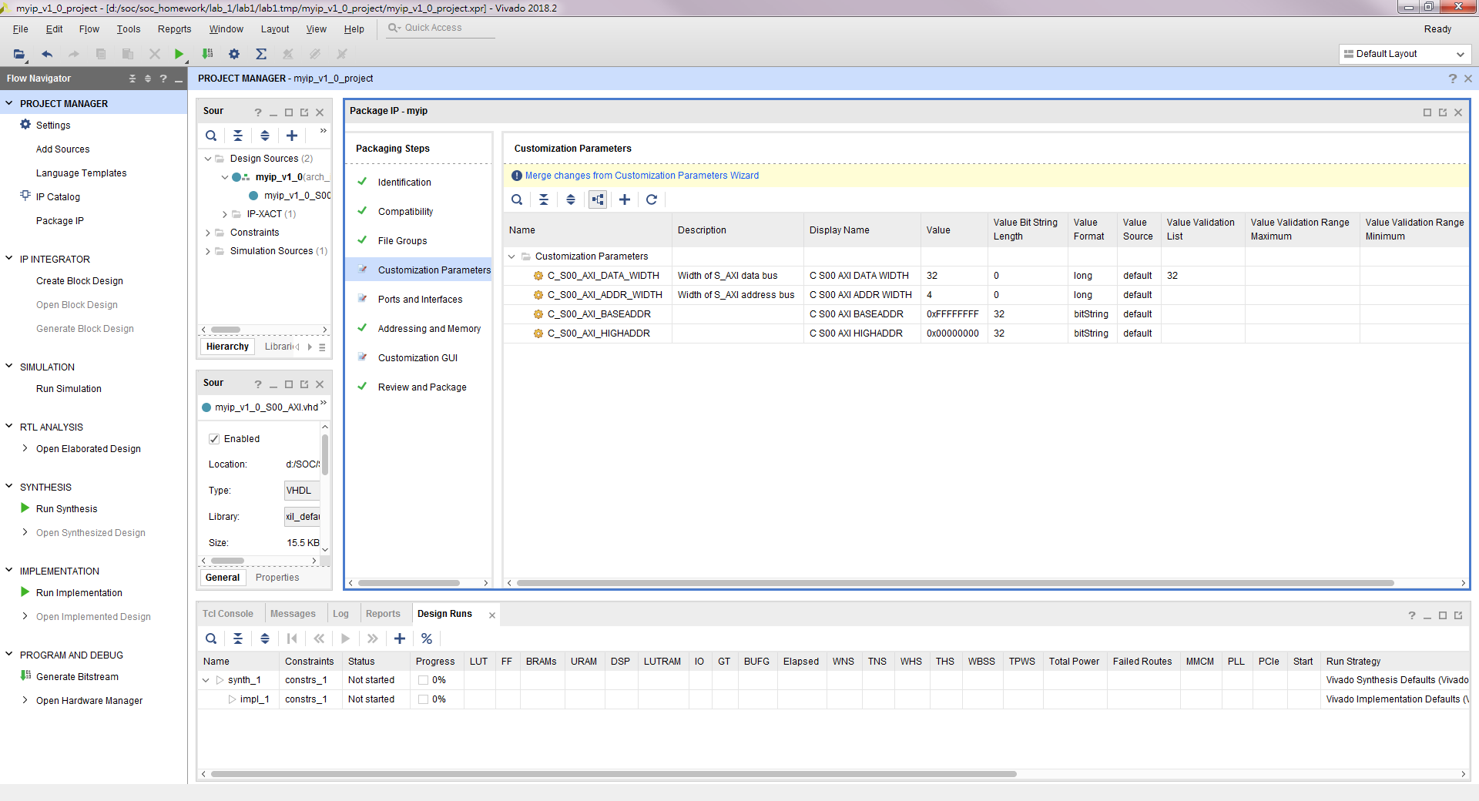
修改IP 完成修改
3
1
2

Slide 22
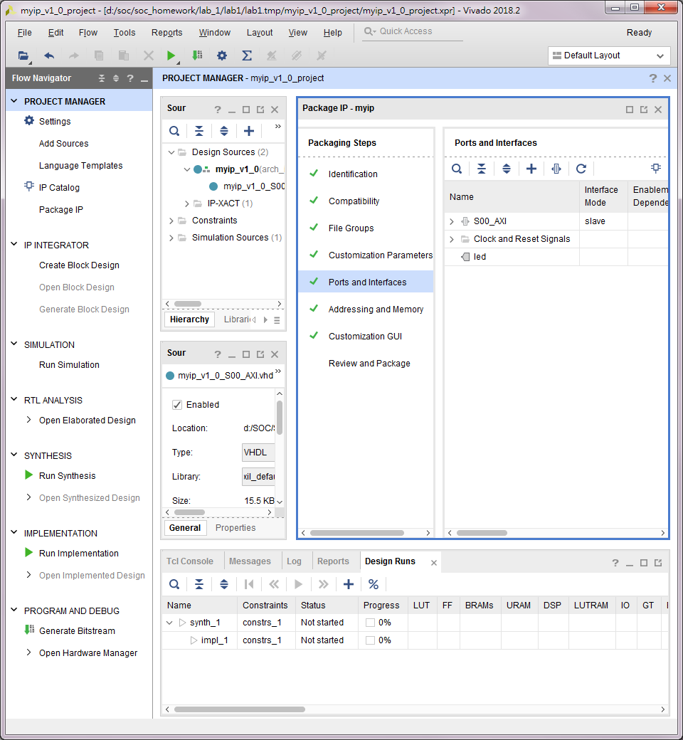
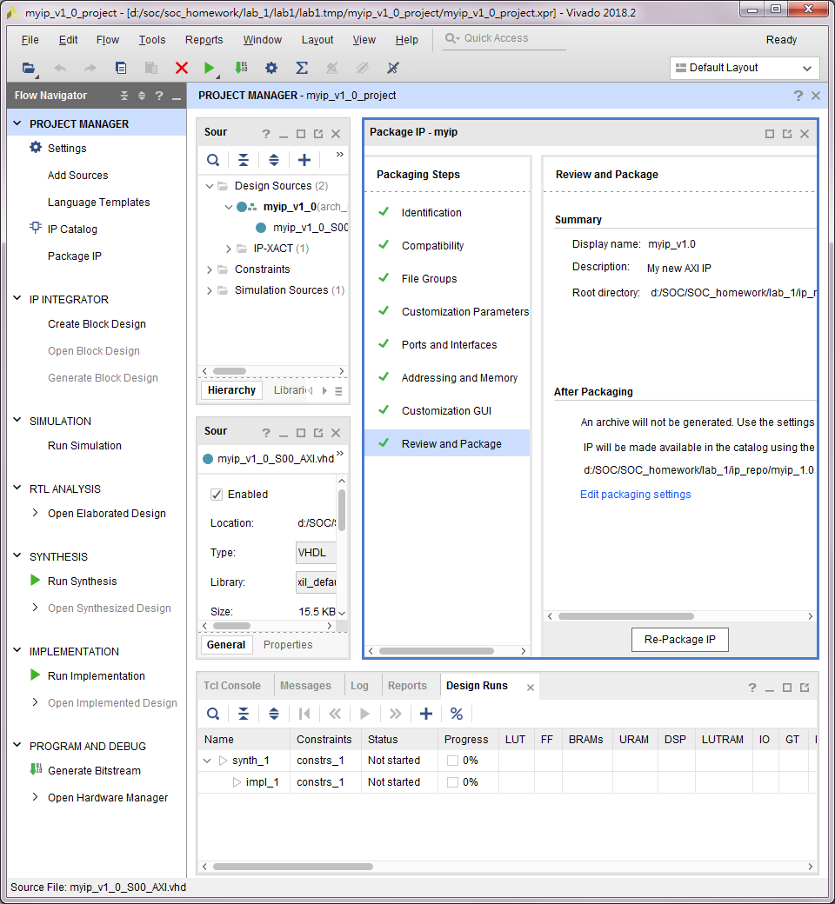
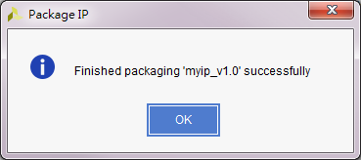
修改IP 完成修改
1
2確認
3
4
5

Slide 23
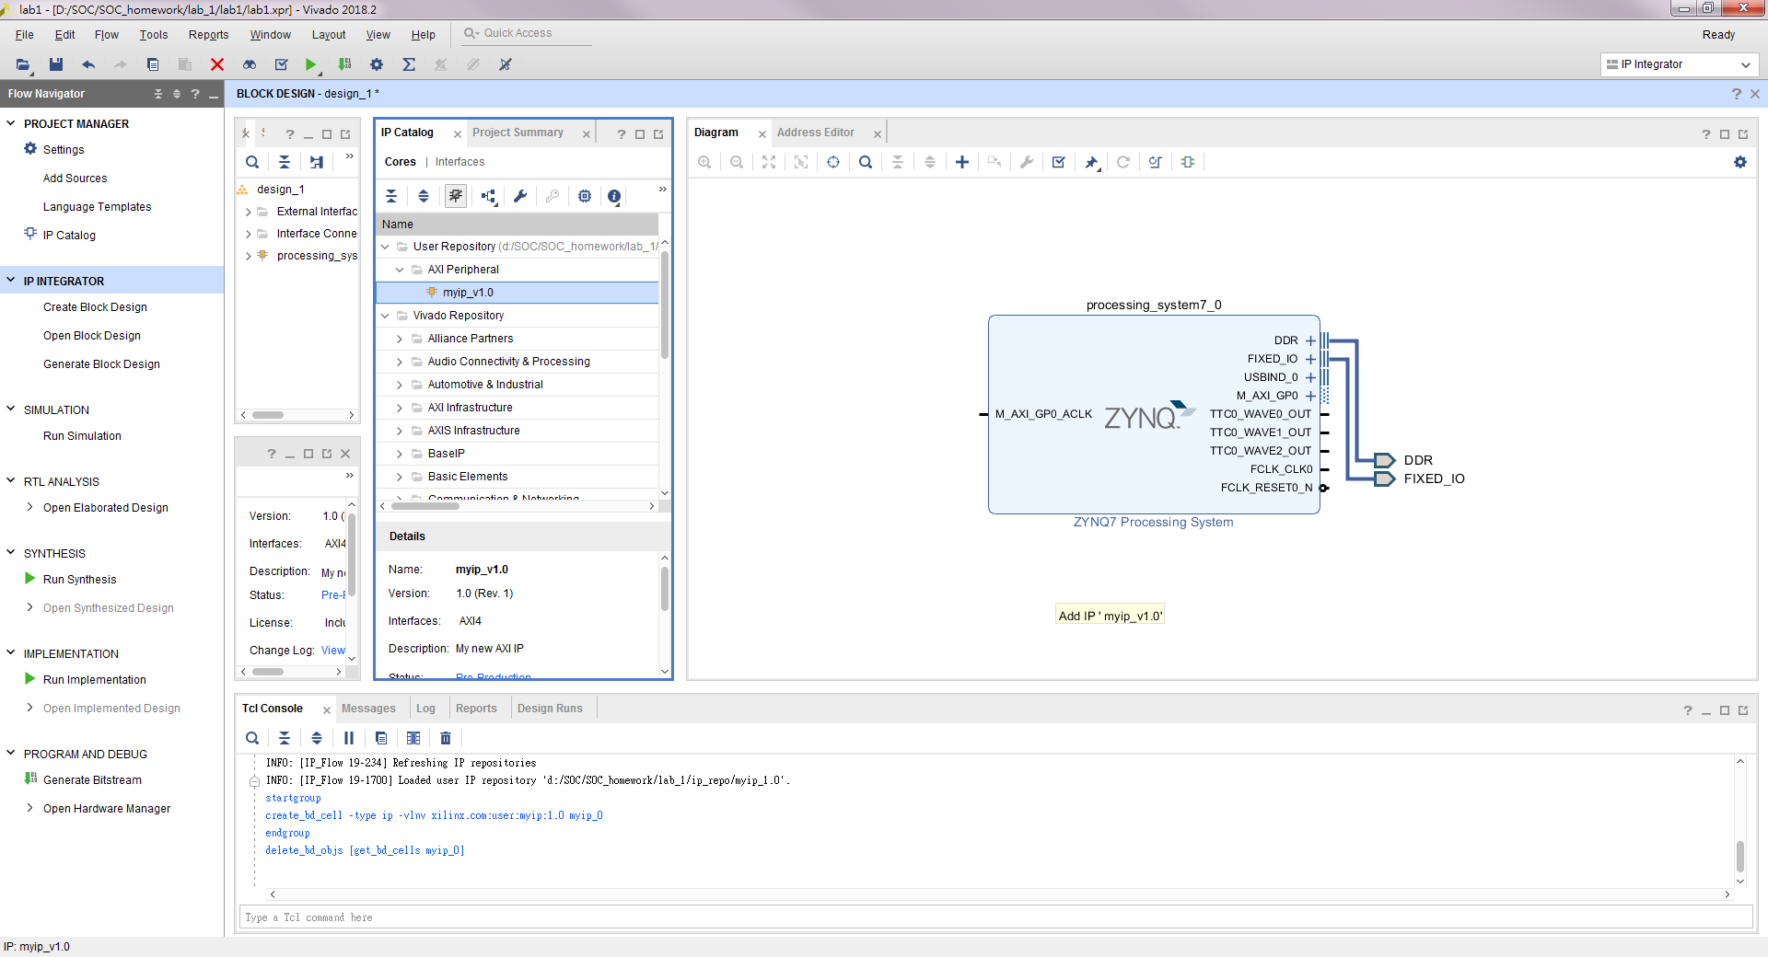
放置IP
1
2按著拖移至Diagram頁

Slide 24
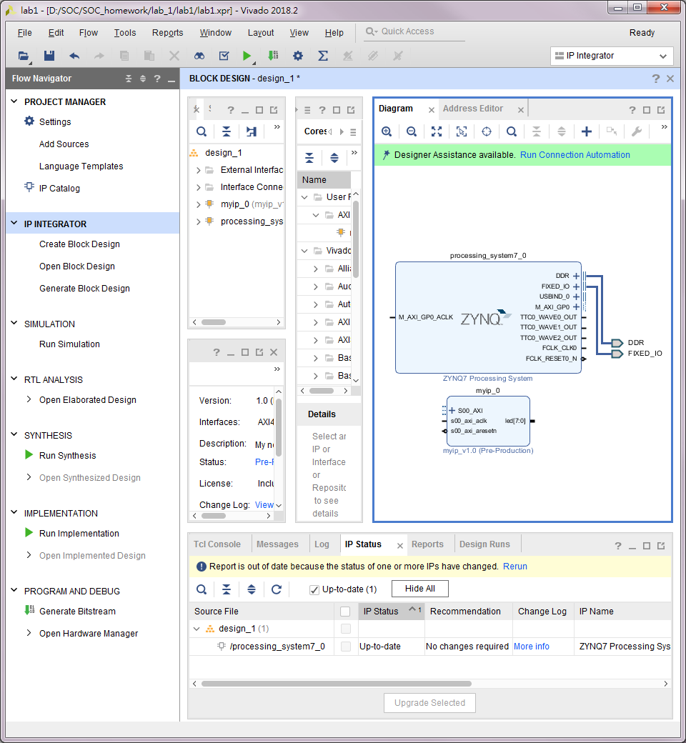
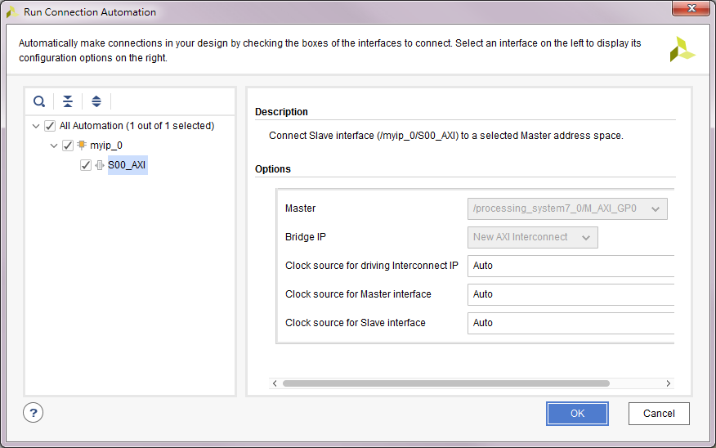
與底板連線
1
2
3

Slide 25
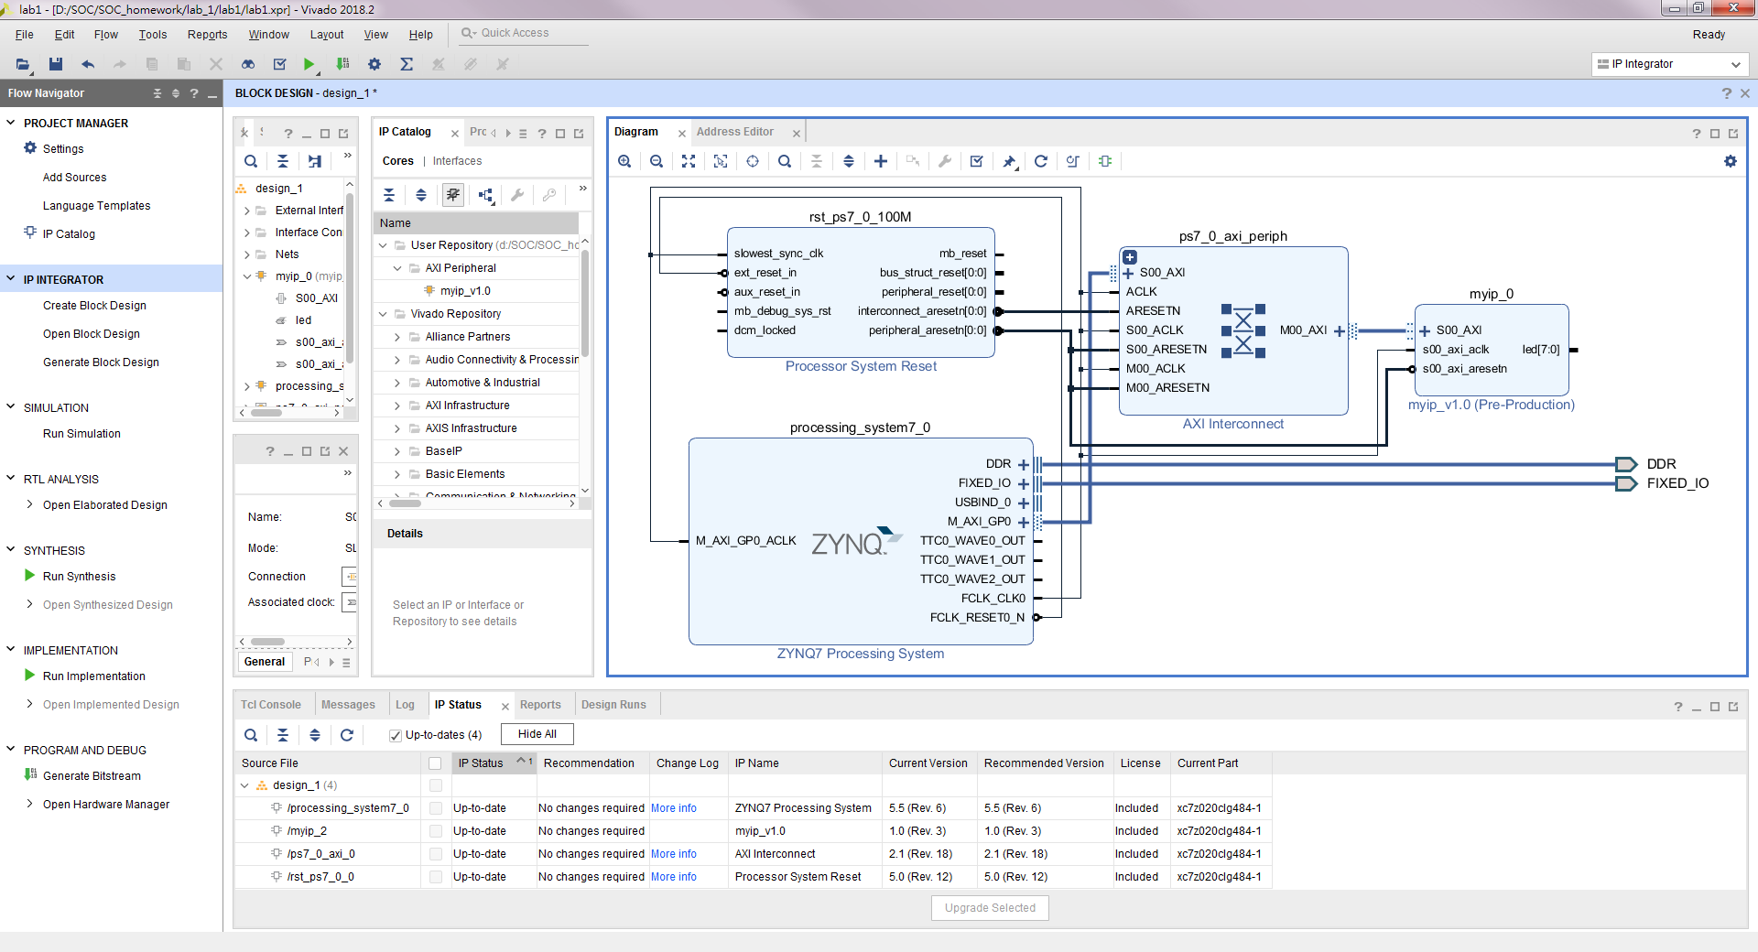
與底板連線

Slide 26
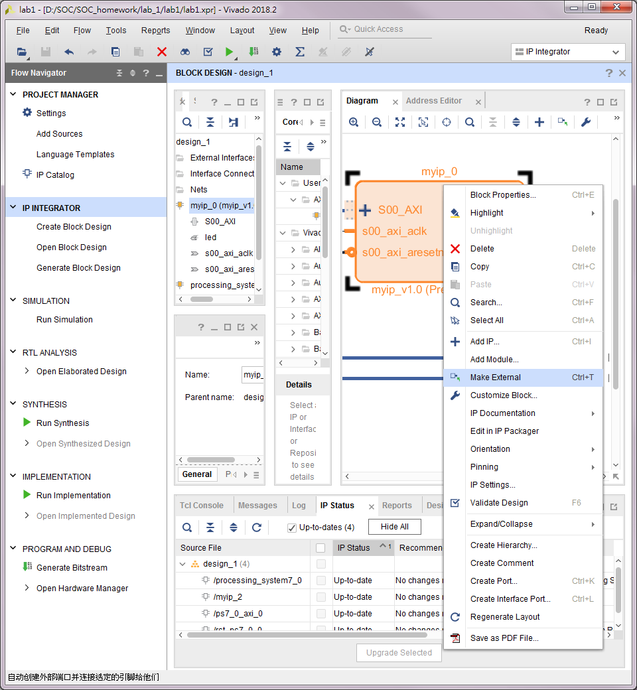
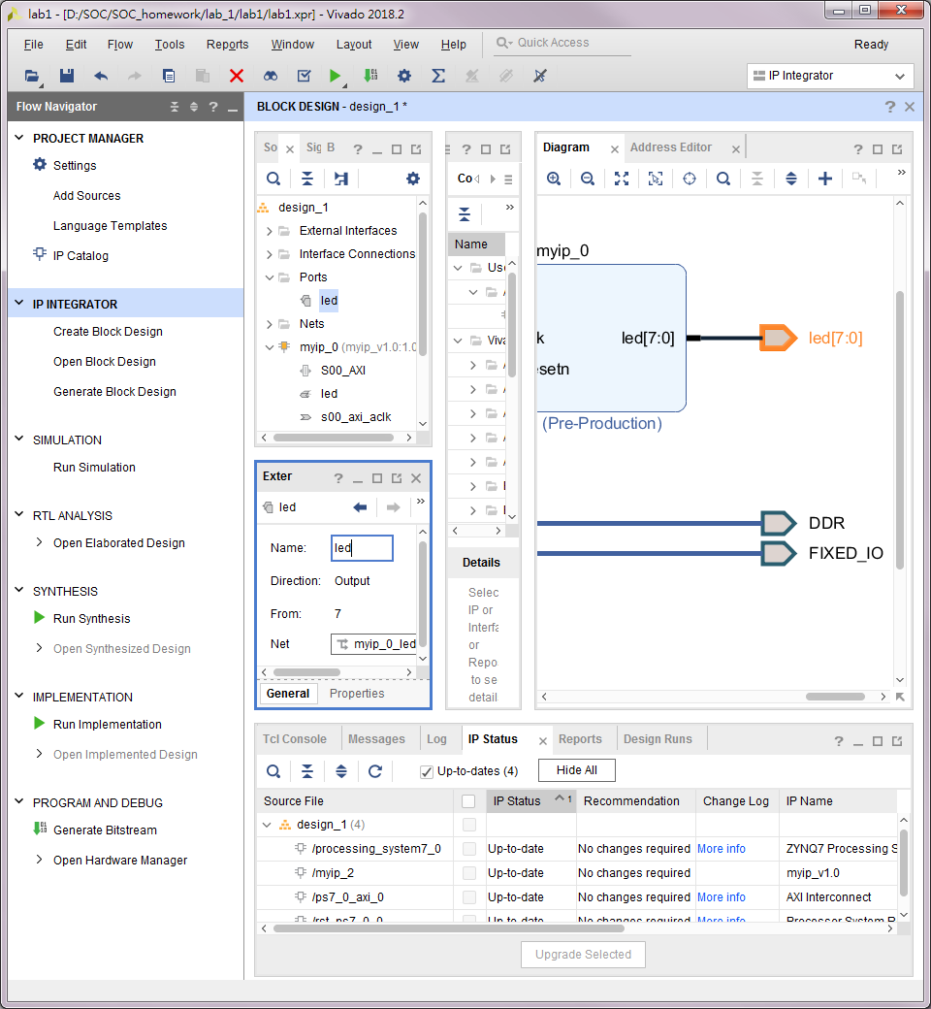
與底板連線
3
1右鍵
2
4改名

Slide 27
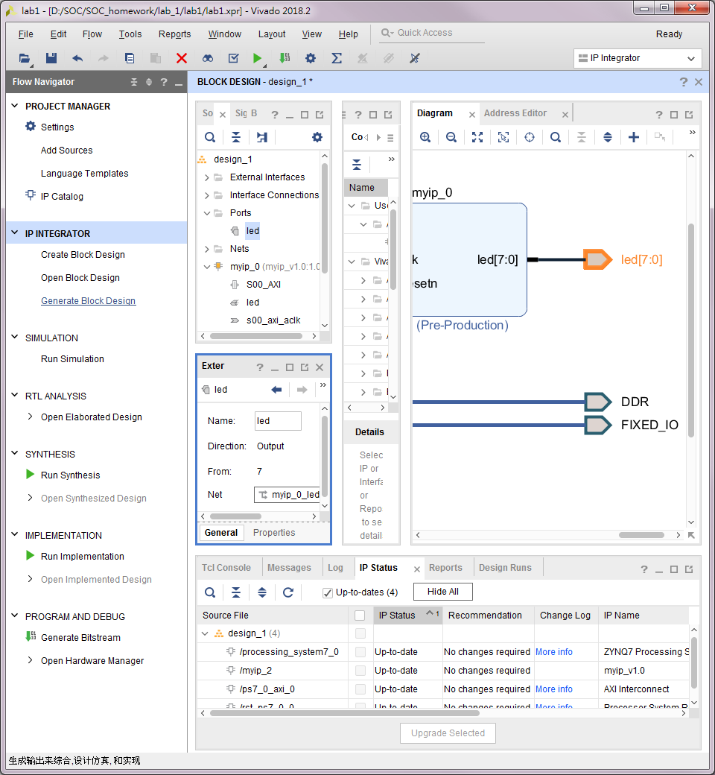
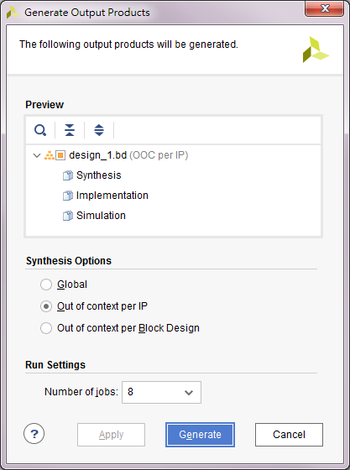
完成封裝
1
2

Slide 28
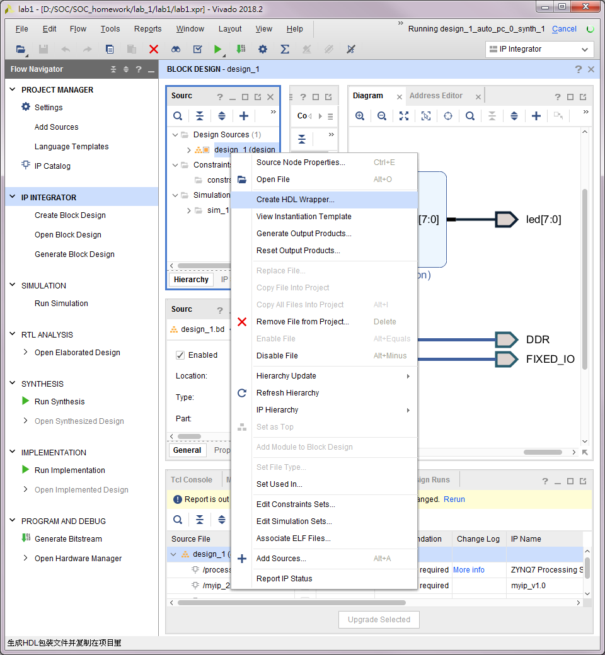
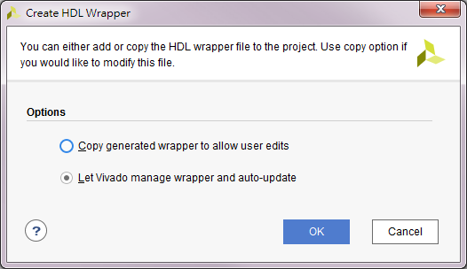
完成封裝
1右鍵
2
3
4

Slide 29
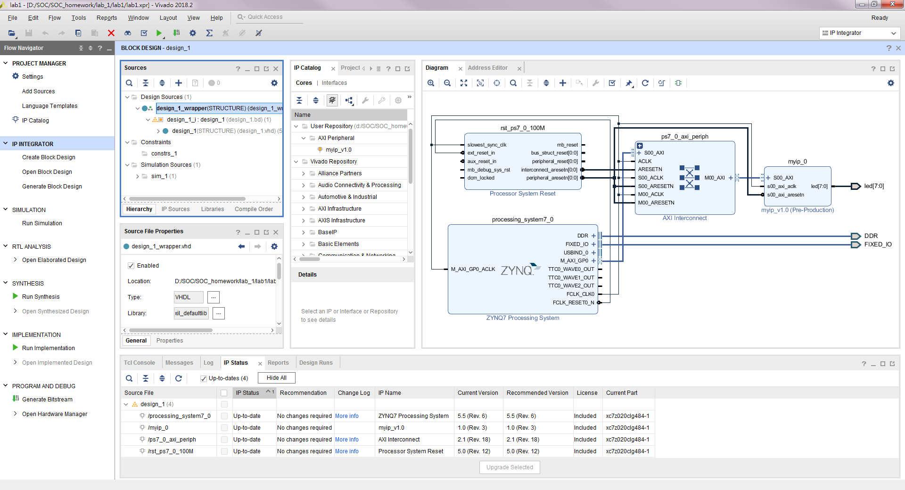
完成封裝
系統產出VHDL CODE

Slide 30
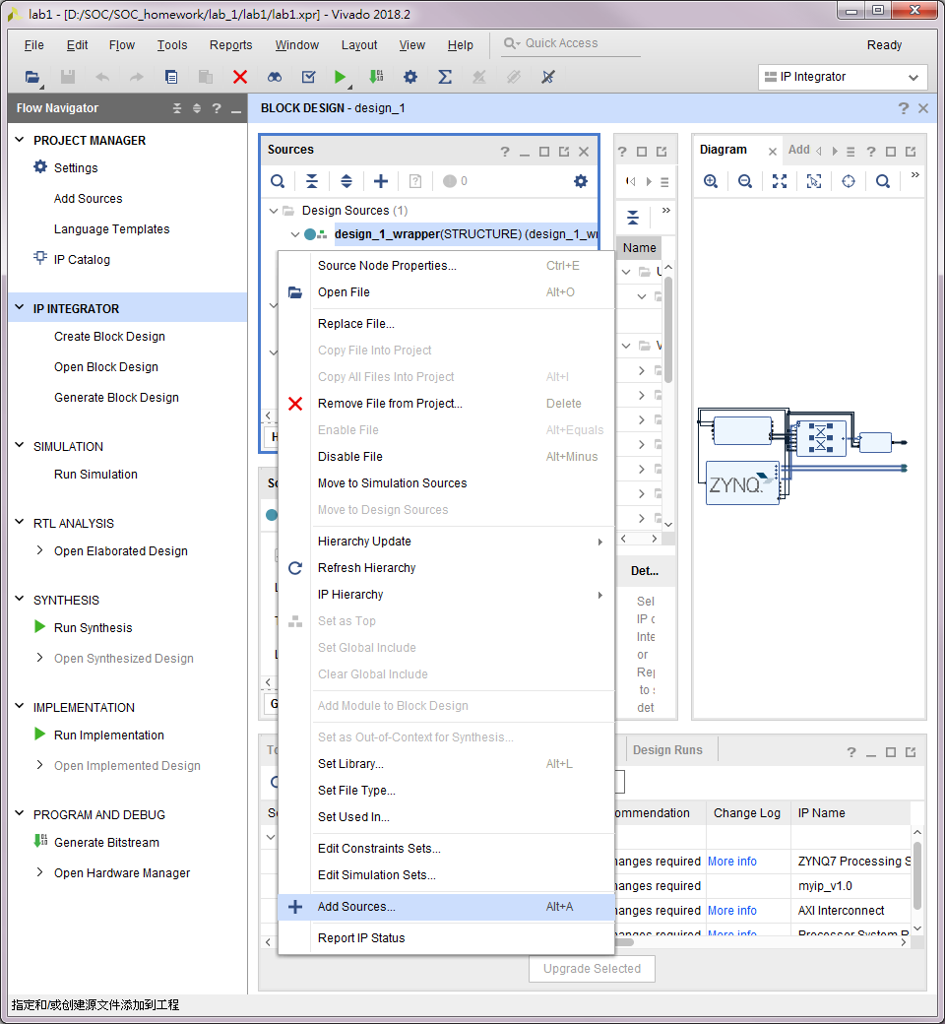

建立.xdc檔
2
1

Slide 31
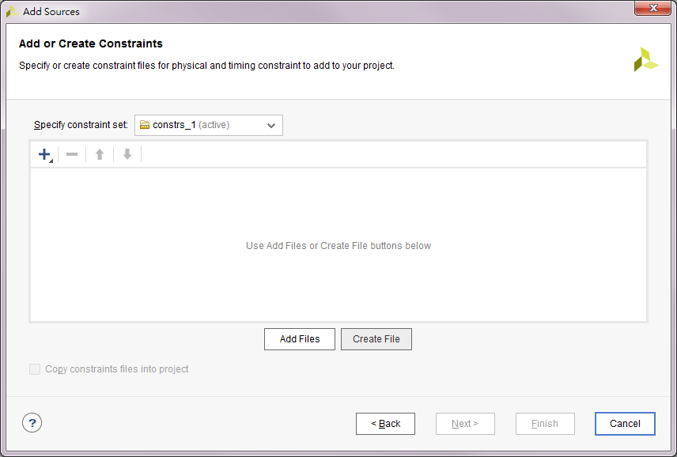
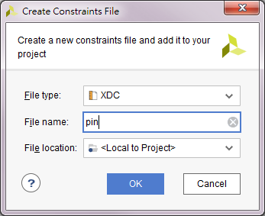
建立.xdc檔
2
1
3

Slide 32
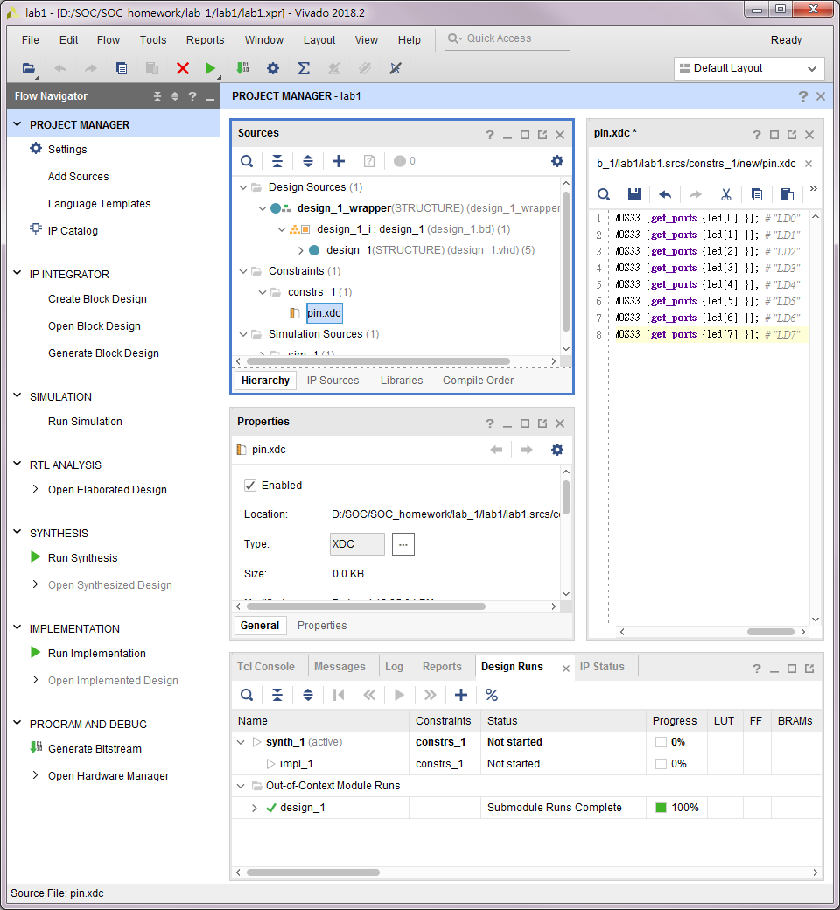
建立.xdc檔
位置
pin.xdc
set_property PACKAGE_PIN T22 [get_ports {led[0] }]; set_property IOSTANDARD LVCMOS33 [get_ports {led[0] }]; # "LD0"
set_property PACKAGE_PIN T21 [get_ports {led[1] }]; set_property IOSTANDARD LVCMOS33 [get_ports {led[1] }]; # "LD1"
set_property PACKAGE_PIN U22 [get_ports {led[2] }]; set_property IOSTANDARD LVCMOS33 [get_ports {led[2] }]; # "LD2"
set_property PACKAGE_PIN U21 [get_ports {led[3] }]; set_property IOSTANDARD LVCMOS33 [get_ports {led[3] }]; # "LD3"
set_property PACKAGE_PIN V22 [get_ports {led[4] }]; set_property IOSTANDARD LVCMOS33 [get_ports {led[4] }]; # "LD4"
set_property PACKAGE_PIN W22 [get_ports {led[5] }]; set_property IOSTANDARD LVCMOS33 [get_ports {led[5] }]; # "LD5"
set_property PACKAGE_PIN U19 [get_ports {led[6] }]; set_property IOSTANDARD LVCMOS33 [get_ports {led[6] }]; # "LD6"
set_property PACKAGE_PIN U14 [get_ports {led[7] }]; set_property IOSTANDARD LVCMOS33 [get_ports {led[7] }]; # "LD7"
1

Slide 33

開始編譯繞線
1

Slide 34

開始編譯繞線
2
1
3

Slide 35


燒錄
1
2
4
3
5

Slide 36

驗證結果

Slide 37
LAB2
輸出到SDK
建立SDK應用專案
執行

Slide 38


輸出到SDK
1
3
4

Slide 39

建立SDK應用專案
1
2

Slide 40


建立SDK應用專案
1
3
2
4

Slide 41

執行 確認裝置UART埠位置
1

Slide 42


執行 開啟目標UART
3
1
2
4

Slide 43


執行 設定
2
1

Slide 44


執行 設定
1雙擊
2

Slide 45


執行 設定
2
1
3

Slide 46

執行 設定
2
1
3

Slide 47

執行 設定
1

Slide 48


執行 設定
2
4
3

Slide 49

執行

Slide 50
LAB3
IP添加中斷
重新佈線
修改.xdc檔
進行編譯
加入中斷的Lab1_ledtest輸出到SDK
建立應用專案led_intr
編寫中斷服務程式
執行設定

Slide 51


IP添加中斷
1
2右鍵
3
4

Slide 52


IP添加中斷 myip_v1_0.vhd
1
3
2
4

Slide 53

IP添加中斷 myip_v1_0.vhd

Slide 54


IP添加中斷 myip_v1_0_S00_AXI.vhd
1
3
2

Slide 55

IP添加中斷 中斷腳位
1
2
3右鍵
4
5

Slide 56

IP添加中斷 完成
1
2

Slide 57

重新佈線
1
2

Slide 58



重新佈線
1
3
2

Slide 59


重新佈線
1
3
2

Slide 60

重新佈線 IP接線圖

Slide 61

重新佈線 定義底板中斷輸入腳位
1雙擊

Slide 62

重新佈線
2
3
1
4

Slide 63

重新佈線 最後IP接線
1

Slide 64

重新佈線
1
2

Slide 65


重新佈線
3
1
2

Slide 66

重新佈線
1
2

Slide 67
修改.xdc檔 內文
set_property PACKAGE_PIN T22 [get_ports {led[0] }]; set_property IOSTANDARD LVCMOS33 [get_ports {led[0] }]; # "LD0"
set_property PACKAGE_PIN T21 [get_ports {led[1] }]; set_property IOSTANDARD LVCMOS33 [get_ports {led[1] }]; # "LD1"
set_property PACKAGE_PIN U22 [get_ports {led[2] }]; set_property IOSTANDARD LVCMOS33 [get_ports {led[2] }]; # "LD2"
set_property PACKAGE_PIN U21 [get_ports {led[3] }]; set_property IOSTANDARD LVCMOS33 [get_ports {led[3] }]; # "LD3"
set_property PACKAGE_PIN V22 [get_ports {led[4] }]; set_property IOSTANDARD LVCMOS33 [get_ports {led[4] }]; # "LD4"
set_property PACKAGE_PIN W22 [get_ports {led[5] }]; set_property IOSTANDARD LVCMOS33 [get_ports {led[5] }]; # "LD5"
set_property PACKAGE_PIN U19 [get_ports {led[6] }]; set_property IOSTANDARD LVCMOS33 [get_ports {led[6] }]; # "LD6"
set_property PACKAGE_PIN U14 [get_ports {led[7] }]; set_property IOSTANDARD LVCMOS33 [get_ports {led[7] }]; # "LD7"
set_property PACKAGE_PIN P16 [get_ports {btn }]; set_property IOSTANDARD LVCMOS18 [get_ports {btn }];

Slide 68

進行編譯
2
1

Slide 69

加入中斷的Lab1_ledtest輸出到SDK
1
2
3
4
5

Slide 70


加入中斷的Lab1_ledtest輸出到SDK
1
2
3

Slide 71

建立應用專案led_intr
1
2

Slide 72


建立應用專案led_intr
1
3
2
4

Slide 73
編寫中斷服務程式—原始碼 helloworld.c
/******************************************************************************
*
* Copyright (C) 2009 - 2014 Xilinx, Inc. All rights reserved.
*
* Permission is hereby granted, free of charge, to any person obtaining a copy
* of this software and associated documentation files (the "Software"), to deal
* in the Software without restriction, including without limitation the rights
* to use, copy, modify, merge, publish, distribute, sublicense, and/or sell
* copies of the Software, and to permit persons to whom the Software is
* furnished to do so, subject to the following conditions:
*
* The above copyright notice and this permission notice shall be included in
* all copies or substantial portions of the Software.
*
* Use of the Software is limited solely to applications:
* (a) running on a Xilinx device, or
* (b) that interact with a Xilinx device through a bus or interconnect.
*
* THE SOFTWARE IS PROVIDED "AS IS", WITHOUT WARRANTY OF ANY KIND, EXPRESS OR
* IMPLIED, INCLUDING BUT NOT LIMITED TO THE WARRANTIES OF MERCHANTABILITY,
* FITNESS FOR A PARTICULAR PURPOSE AND NONINFRINGEMENT. IN NO EVENT SHALL
* XILINX BE LIABLE FOR ANY CLAIM, DAMAGES OR OTHER LIABILITY,
* WHETHER IN AN ACTION OF CONTRACT, TORT OR OTHERWISE, ARISING FROM, OUT OF
* OR IN CONNECTION WITH THE SOFTWARE OR THE USE OR OTHER DEALINGS IN THE
* SOFTWARE.
*
* Except as contained in this notice, the name of the Xilinx shall not be used
* in advertising or otherwise to promote the sale, use or other dealings in
* this Software without prior written authorization from Xilinx.
*
******************************************************************************/
/*
* helloworld.c: simple test application
*
* This application configures UART 16550 to baud rate 9600.
* PS7 UART (Zynq) is not initialized by this application, since
* bootrom/bsp configures it to baud rate 115200
*
* ------------------------------------------------
* | UART TYPE BAUD RATE |
* ------------------------------------------------
* uartns550 9600
* uartlite Configurable only in HW design
* ps7_uart 115200 (configured by bootrom/bsp)
*/
#include <stdio.h>
#include "platform.h"
#include "xil_io.h"
#include "xil_types.h"
#include "xparameters.h"
#include "xil_exception.h"
#include "xscugic.h"
#include "myip.h"
#include "sleep.h"
#include "xil_printf.h" //若會出錯則此行註解掉
XScuGic InterruptController; /* Instance of the Interrupt Controller */
static XScuGic_Config *GicConfig;/* The configuration parameters of the controller */
int XPAR_FABRIC_MYIP_0_INTR_INTR = 61;//######interrupt number####################(vivado2017.4此行可註解)
void INTERRUPT_Handler0(void *baseaddr_p){
int i;
print("Push Button was pressed\r\n");
//xil_printf("Push Button was pressed\r\n");
for(i=0;i<2;i++){
MYIP_mWriteReg(0x43C00000, MYIP_S00_AXI_SLV_REG0_OFFSET, 0xf0);
usleep(500000);
MYIP_mWriteReg(0x43C00000, MYIP_S00_AXI_SLV_REG0_OFFSET, 0x0f);
usleep(500000);
}
}
int ScuGicInterrupt_Init(void)
{
int Status;
/*
* Initialize the interrupt controller driver so that it is ready to
* use.
* */
Xil_ExceptionInit();
GicConfig = XScuGic_LookupConfig(XPAR_PS7_SCUGIC_0_DEVICE_ID);
if (NULL == GicConfig) {
return XST_FAILURE;
}
Status = XScuGic_CfgInitialize(&InterruptController, GicConfig,
GicConfig->CpuBaseAddress);
if (Status != XST_SUCCESS) {
return XST_FAILURE;
}
/*
* Setup the Interrupt System
* */
/*
* Connect the interrupt controller interrupt handler to the hardware
* interrupt handling logic in the ARM processor.
*/
Xil_ExceptionRegisterHandler(XIL_EXCEPTION_ID_IRQ_INT,
(Xil_ExceptionHandler) XScuGic_InterruptHandler,
(void *) &InterruptController);
/*
* Connect a device driver handler that will be called when an
* interrupt for the device occurs, the device driver handler performs
* the specific interrupt processing for the device
* since the xparameters.h file doesnt detect the external interrupts, we have to manually
* use the IRQ_F2P port numbers ; 91, 90, ect..
*/
Status = XScuGic_Connect(&InterruptController,XPAR_FABRIC_MYIP_0_INTR_INTR,
(Xil_ExceptionHandler)INTERRUPT_Handler0,
(void *)&InterruptController);
XScuGic_Enable(&InterruptController, XPAR_FABRIC_MYIP_0_INTR_INTR);
/*
* Enable interrupts in the ARM
*/
Xil_ExceptionEnable();
/*
* Set interrupts PriorityTriggerType
*/
XScuGic_SetPriorityTriggerType(&InterruptController, XPAR_FABRIC_MYIP_0_INTR_INTR,
0xa0, 3);
if (Status != XST_SUCCESS)
return XST_FAILURE;
}
int main()
{
int xstatus;
// Interrupt Test
xstatus = ScuGicInterrupt_Init();
if (xstatus != XST_SUCCESS)
return XST_FAILURE;
// Wait For interrupt;
print("Wait for the interrupt to trigger \r\n");
print("########################################\r\n");
print(" \r\n");
int i=0;
while(1){
for(i=0;i<=255;i++){
MYIP_mWriteReg(0x43C00000, MYIP_S00_AXI_SLV_REG0_OFFSET, i);
printf("i = %d \r\n",i);
sleep(1);
}
}
return 0;
}

Slide 74

編寫中斷服務程式—offset address
1

Slide 75


執行設定
1
2
6
3
4
5

Slide 76

執行設定
1
2

Slide 77

執行

Slide 78

中斷
查詢資料手冊 :
https://www.xilinx.com/support/documentation/user_guides/ug585-Zynq-7000-TRM.pdf

Slide 79

中斷 Interrupt Controller Register Overview

Slide 80

中斷 PS and PL Shared Peripheral Interrupts (SPI)

